Slide 1


NSW Drug and Alcohol Testing Identity Cards Discussion
March 2019

Slide 2
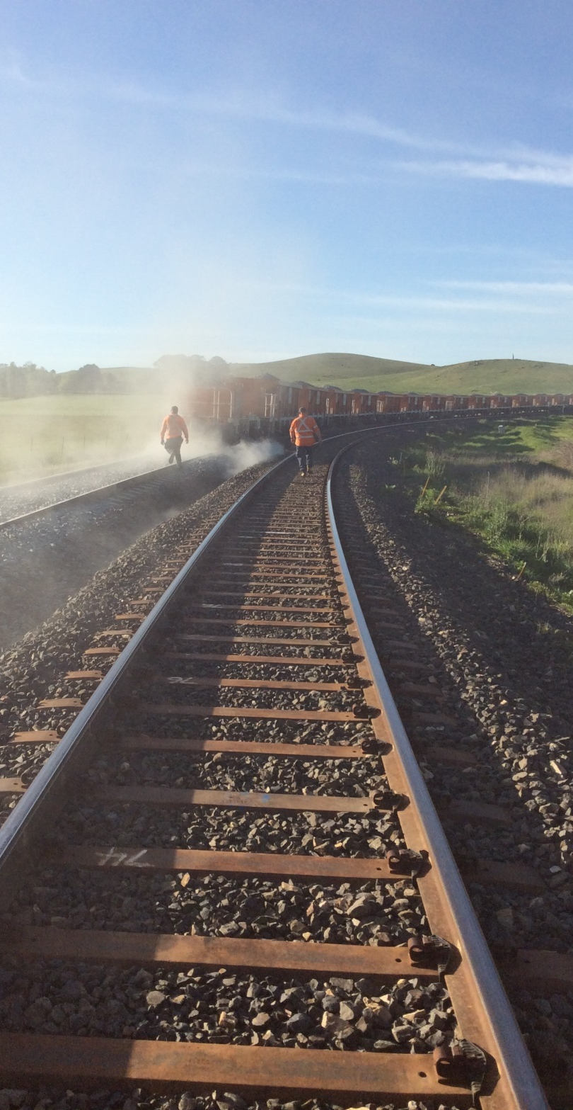
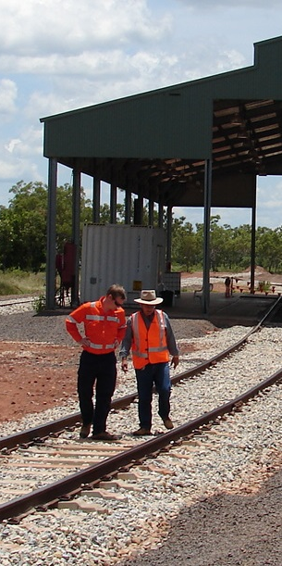
Introduction
ONRSR is proposing changes to the process for issuing identity cards for authorised persons for D&A testing in NSW and we are seeking your input.
NSW D&A identity cards have been required in NSW since before ONRSR was established and were previously issued by operators.
Discussion:
1. Any comments on the current process?

Slide 3
Proposal
To transfer the identify card management function to RTOs and third party service providers.
Sub-delegations to industry to appoint authorised persons would be expanded to include identity card issue and return.
Industry would appoint authorised persons and issue them with their instruments of appointment and identity cards.

Slide 4

Why?
  Streamline the process of issuing identity cards for both industry and ONRSR, by allowing operators and third party service providers to exercise their sub-delegation more efficiently.
  Reduce the wait-time for the issue of identity cards.

Slide 5
Process: what stays the same?
  Regulator delegates to Director Operations.
  Director Operations sub-delegates to RTO or third party service provider representatives (not more than three per organisation).
  RTO or third party service provider representatives appoint authorised persons.
  Need to ensure authorised persons are appropriately trained.
  Need to keep records:
  Training
  Instruments of appointment
  Register of authorised persons including card issue (max. 3 years) and return dates

Slide 6
Process: what would be different?
  Delegations
  The sub-delegation would need to be amended to include card issue and return.
  Card production and management
  RTO or third party service provider would produce cards.
  Cards would be returned to the RTO or third party service provider when they expire or an individual ceases to be an authorised person.
  Reporting
  RTO or third party service provider would report annually:
  Number of authorised persons currently appointed
  Number of appointments made in the year
  Number of appointments terminated in the year

Slide 7
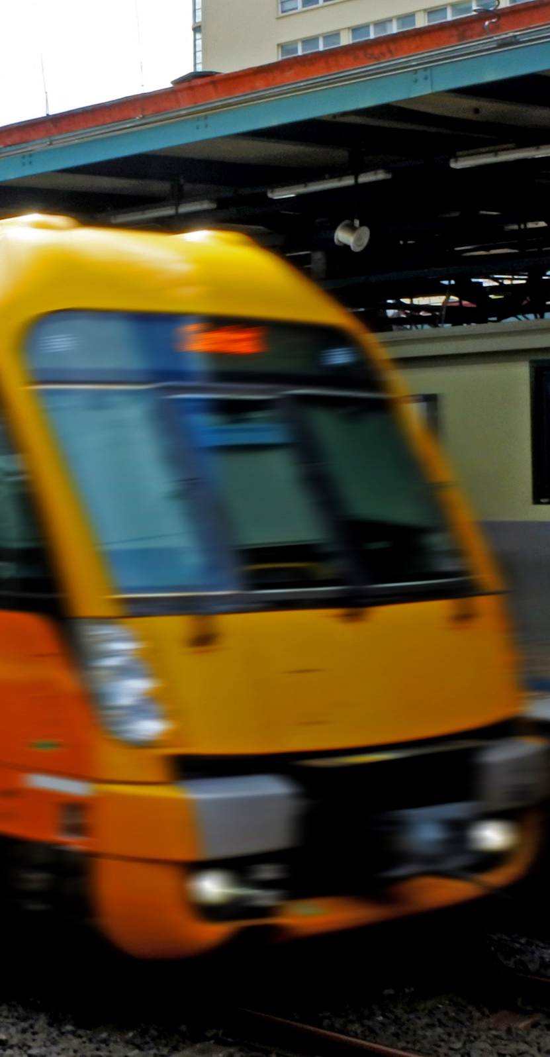
Process
Discussion:
Do you have any comment on the proposed process?
  Delegations?
  Card production and management?
  Reporting?
What else do we need to consider?

Slide 8
Summary of Requirements
  Authorised Person training
  Instruments of appointment issued to authorised persons and records kept
  Identity cards:
    Cards must be issued to authorised persons
    Cards must be returned when a person ceases to be authorised
    A register of authorised persons must be maintained
    Current cards are still valid, and must be returned to ONRSR when they expire, or a person ceases to be authorised
  RTOs and third party service providers must report annually on their authorised person appointment process.

Slide 9

Implementation considerations
ONRSR would need to revise all the sub-delegations and to clearly communicate expectations in relation to issuing the cards.
You would need to ensure you have your systems and processes in place.
Discussion:
4. How much notice is required?

Slide 10

Next steps
Advise you of the outcome of these discussions
Develop guidance materials
Allow a reasonable time for any changeover

Slide 11

Any questions?

